Slide 1
Möbius Strips
Shelbi Babcock

Slide 2
Goals, Objectives, and Materials
Goal: -The students will learn about the characteristics of a Möbius Strip. -The students will discover relationships between the number of twists in the strip and the number of edges and sides present.
Objective: -Given a strip of paper and tape, the student will create a Möbius Strip. -Using the Möbius Strip they created, the student will determine the number of edges and sides of the Möbius Strip. -Using information from some trials on the data chart, the students will predict a relationship between the number of twists in the strip and the number of edges and sides that it has. -Using strips of paper, tape, and a chart, the student will state the relationship between the number of twists in the strip and the number of edges and sides that it has.
Materials: -Multiple strips of paper -Tape -Data Chart -highlighter/marker -pencil

Slide 3
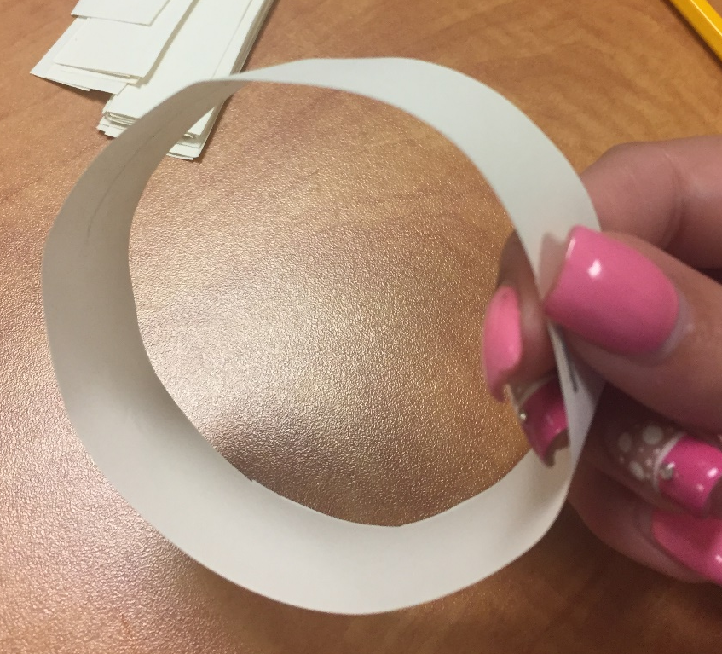
Explore a Basic Loop
The activity will begin with the exploration some properties of a basic loop.
Take a strip of paper and pull the ends together.
Secure the ends together with tape.

Slide 4
Explore a Basic Loop
How many sides does the loop have?
How many edges?

Slide 5
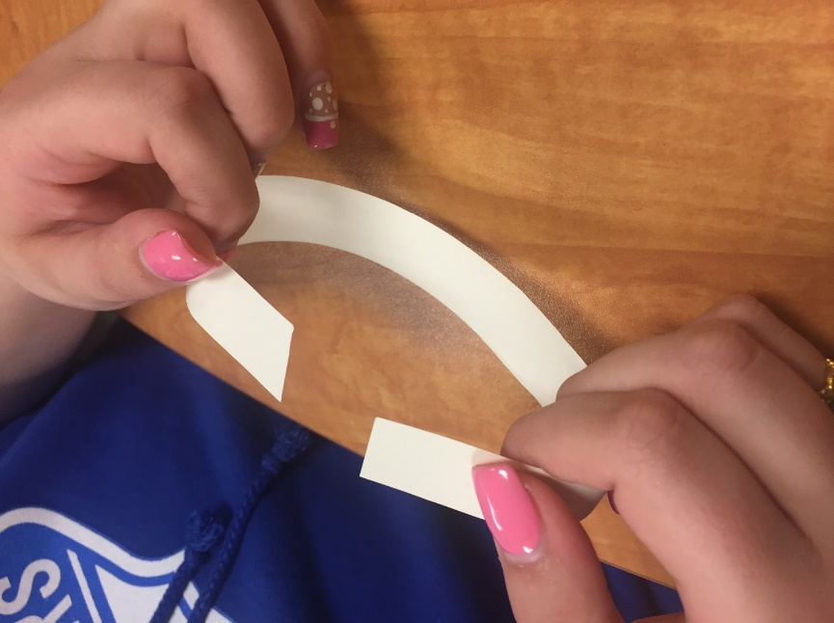
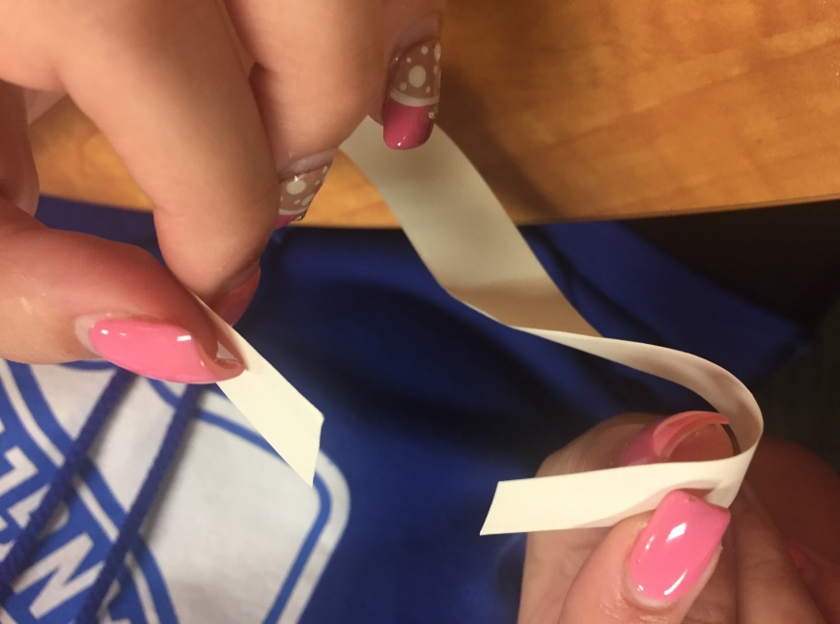
Make a Möbius Strip
Take a new strip and pull the ends together. Before you tape it, take one end and twist it 180 degrees. Now tape the ends together.

Slide 6
What is a Möbius Strip
Look at the figure you created.
How many sides do you think this figure has? How many edges?
Turn to your neighbor and tell them your predictions.

Slide 7
What is a Möbius Strip
We can determine how many sides the Möbius Strip has by performing a simple test.
Take a pencil and place it in the center of the strip. Draw a straight line around the strip until you reach where you started without lifting the pencil.

Slide 8
What is a Möbius Strip
What do you notice?
What do you think this shows about the number of sides of a Möbius Strip?

Slide 9
What is a Möbius Strip
*Characteristic #1 of a Möbius Strip*
A Möbius Strip is a single-sided figure.

Slide 10
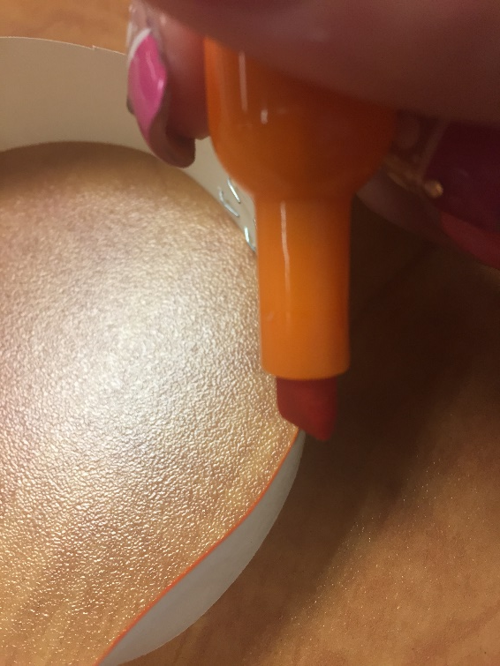
What is a Möbius Strip
We can determine how many edges the Möbius Strip has by performing a similar test.
Now take a highlighter/marker and place it on an edge of the strip. Color along the edge until you reach where you started without lifting the highlighter/marker.

Slide 11
What is a Möbius Strip
What do you notice?
What do you think this shows about the number of edges of a Möbius Strip?

Slide 12
What is a Möbius Strip
*Characteristic #2 of a Möbius Strip*
A Möbius Strip has only one edge.

Slide 13
What is a Möbius Strip
The Möbius Strip is named after August Ferdinand Möbius, a nineteenth century German mathematician and astronomer who was a pioneer in the field of topology. The design of the Möbius Strip has practical applications in industry. The design has been used for conveyor belts and continuous-loop recording tapes.

Slide 14
Can We Find Patterns?
Using the information we just found fill in the data chart for the number of sides and edges for a Möbius Strip (1- 180$°$ twist). Using the other strips, complete the same process as above with each number of 180$°$ twists. Determine the number of sides and edges for each and fill out the data chart.
Number of 180˚ Twists | Number of Sides | Number of Edges
1 (Möbius Strip) | 1 | 1

Slide 15
Does Your Data Chart Match Mine?
Do you have a prediction for how the table might be completed for 5 and 6 twists based on the table so far?
Discuss your prediction and your reasoning for it with your neighbor.

Slide 16
Does Your Data Chart Match Mine?
Number of 180˚ Twists | Number of Sides | Number of Edges
1 (Möbius Strip) | 1 | 1
2 | 2 | 2
3 | 1 | 1
4 | 2 | 2
5 | 1 | 1
6 | 2 | 2

Slide 17
What is the pattern?
Number of 180˚ Twists | Number of Sides | Number of Edges
1 (Möbius Strip) | 1 | 1
2 | 2 | 2
3 | 1 | 1
4 | 2 | 2
5 | 1 | 1
6 | 2 | 2
Using the chart, state the relationship that exists between the number of 180 degree twists and the number of sides and edges that the figure has.

Slide 18
Reference
RAFT Education Department. (2015). The magical strip. Retrieved April 25, 2017,
from http://www.raftsac.org/ideas/Magical%20Strip.pdf

